Slide 1
PCI Bus Architecture

Slide 2
Introduction
A computer bus is used to transfer data from one location or device on the motherboard to the central processing unit where all calculations take place.
Two different parts of a Bus
  Address bus-transfers information about where the data should go
  Data bus-transfers the actual data

Slide 3
History
The PCI architecture was designed as a replacement for the ISA standard, with three main goals: to get better performance when transferring data between the computer and its peripherals, to be as platform independent as possible, and to simplify adding and removing peripherals to the system.
PCI(Peripheral Component Interconnect) bus is based on ISA (Industry Standard Architecture) Bus and VL (VESA Local) Bus.
Introduced by Intel in 1992
Revised twice into version 2.1 which is the 64-bit standard that it is today.
Great feature of PCI Bus was that it was invented as an industry standard
PCI provides direct access to system memory for the devices that are connected to the bus which is then connected through a bridge that connects to the front side bus.
This configuration allowed for higher performance without slowing down the processor

Slide 4
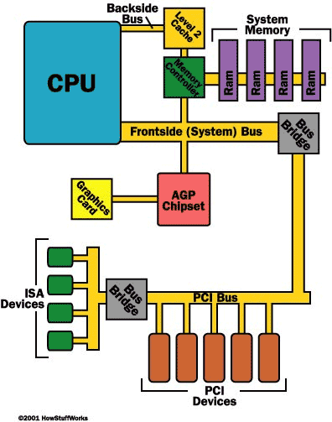
History
The PCI Bus was originally 33Mhz and then changed to 66Mhz. 133-MHz implementations have recently been deployed
“Plug and Play” utilized the PCI bus concept.
PCI is currently
used extensively on IA-32, Alpha, PowerPC, SPARC64, and IA-64 systems, and some other platforms as well.

Slide 5
How PCI Compares to Other Buses
Bus Type | Bus Width | Bus Speed | MB/sec | Advantages | Disadvantages
ISA | 16 bits | 8MHz | 16 MBps | low cost, compatibility, widely used | low speed, Jumpers & DIP switches. becoming obsolete
PCI | 64 bits | 133 MHz | 1 GBps | very high speed, Plug & Play, dominant board-level bus | incompatible with older systems, can cost more
CompactPCI | 64 bits | 33MHz | 132 MBps | designed for industrial use, hot swapping/Plug & Play, ideal for embedded systems | lower speed than PCI, need adapter for PC use, incompatible with older systems
Table 1: How PCI compares to other buses (Tyson, 2004a; Quatech, 2004c)

Slide 6
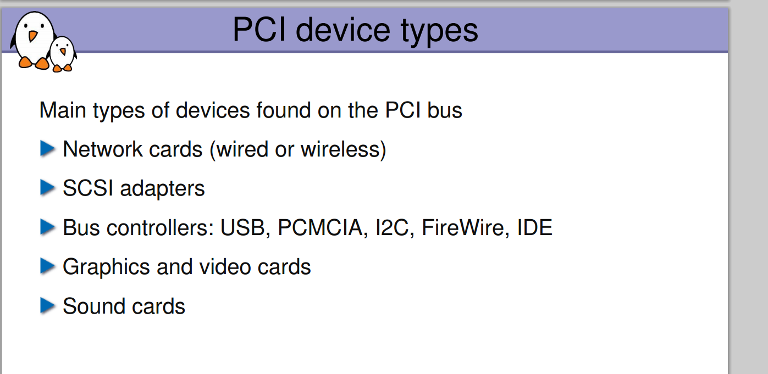

Slide 7
Plug and Play
What is most relevant to the driver writer, however, is PCI’s support for auto detection of interface boards. PCI devices are jumper less and are automatically configured at boot time. Then, the device driver must be able to access configuration information in the device in order to complete initialization. This happens without the need to perform any probing.
Requirements for full implementation:
  Plug and Play BIOS
  Extended System Configuration Data (ESCD)
  Plug and Play operating system
Tasks it automates:
  Interrupt Requests (IRQ)
  Direct Memory Access (DMA)
  Memory Addresses
  Input/Output (I/O) Configuration
  (Tyson, 2004b)

Slide 8
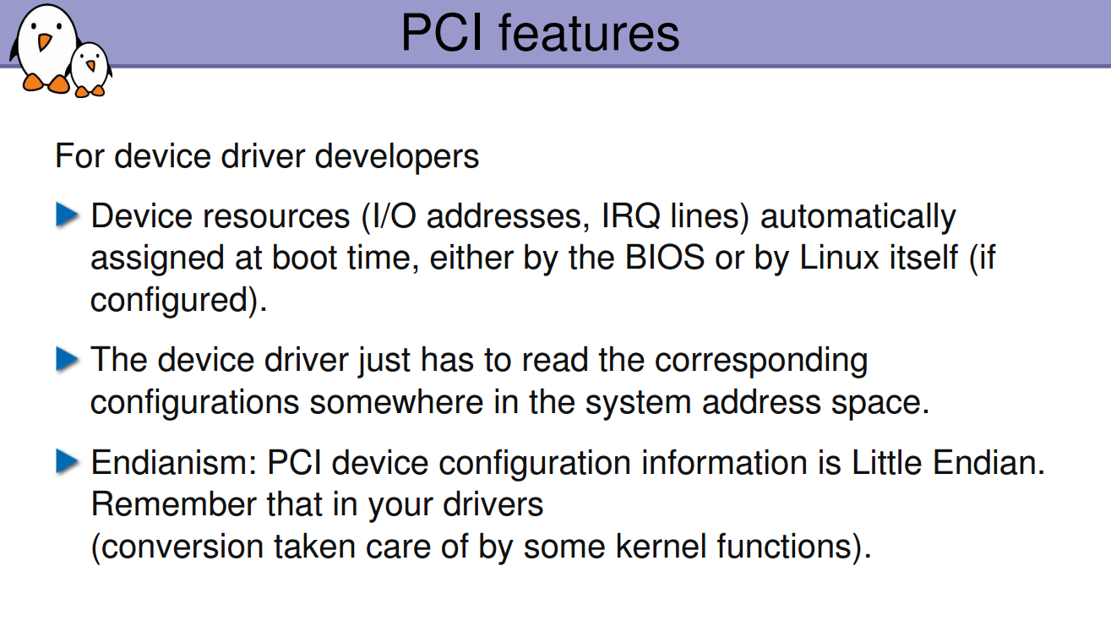

Slide 9
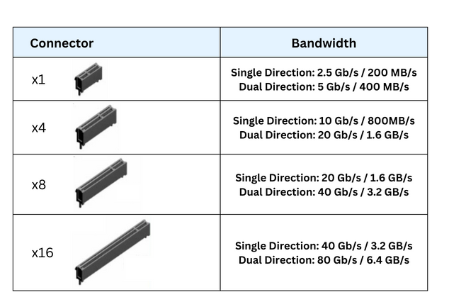
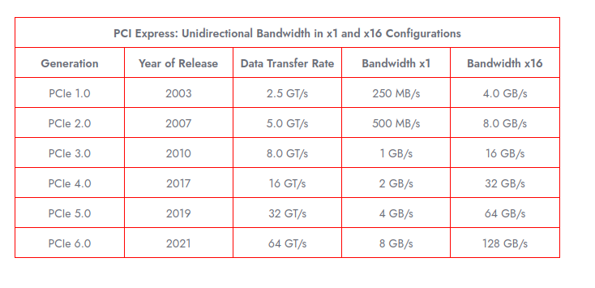

Slide 10
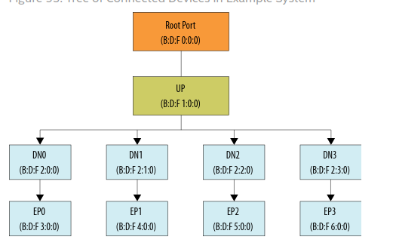
$lspci -tv

Slide 11
PCI Addressing:
Each PCI peripheral is identified by a bus number, a device number, and a function number. The PCI specification permits a single system to host up to 256 buses, but because 256 buses are not sufficient for many large systems, Linux now supports PCI domains. Each PCI domain can host up to 256 buses. Each bus hosts up to 32 devices, and each device can be a multifunction board (such as an audio device with an accompanying CD-ROM drive) with a maximum of eight functions.
Most recent workstations feature at least two PCI buses. Plugging more than one bus
in a single system is accomplished by means of bridges, special-purpose PCI peripherals
whose task is joining two buses
$ lspci | cut -d: -f1-3
$ cat /proc/bus/pci/devices | cut -f1
$ tree /sys/bus/pci/devices/
Taking the VGA video controller as an example, 0x00a0 means 0000:00:14.0 when split into domain (16 bits), bus (8 bits), device (5 bits) and function (3 bits).
The hardware circuitry of each peripheral board answers queries pertaining to three
address spaces: memory locations, I/O ports, and configuration registers. The first
two address spaces are shared by all the devices on the same PCI bus (i.e., when you
access a memory location, all the devices on that PCI bus see the bus cycle at the
same time). The configuration space, on the other hand, exploits geographical
addressing. Configuration queries address only one slot at a time, so they never collide

Slide 12
To see how PCI works, we start from system boot, since that’s when the devices are configured.
When power is applied to a PCI device, the hardware remains inactive. In other words, the device responds only to configuration transactions. At power on, the device has no memory and no I/O ports mapped in the computer’s address space; every other device-specific feature, such as interrupt reporting, is disabled as well.
Fortunately, every PCI motherboard is equipped with PCI-aware firmware, called the BIOS, NVRAM, or PROM, depending on the platform. Either the BIOS or the operating system geographically addresses the PCI slots (for example, the first PCI slot, the second PCI slot, or the third PCI slot, etc., on the motherboard) through the PCI controller using the per slot IDSEL (Initialization Device Select) signals. The firmware offers access to the device configuration address space by reading and writing registers in the PCI controller.
To address a PCI device, it must be enabled by being mapped into the system's I/O port address space or memory-mapped address space. At system boot, the firmware (or the Linux kernel, if so configured) performs configuration transactions with every PCI peripheral in order to allocate a safe place for each address region it offers. The OS program the Base Address Registers (commonly called BARs) to inform the device of its address mapping by writing configuration commands to the PCI controller. By the time a device driver accesses the device, its memory and I/O regions have already been mapped into the processor’s address space. The driver can change this default assignment, but it never needs to do that.

Slide 13
PCI Bus Enumeration:
Since there is no direct method for the BIOS or operating system to determine which PCI slots have devices installed (nor which functions the device implements) the PCI bus(es) must be enumerated.
Bus enumeration is performed by attempting to read the vendor register and device ID register for each
combination of bus number and device number at the device's function #0.
If no response is received from the device's function #0, the bus master performs an abort and returns
an all-bits-on value (FFFFFFFF in hexadecimal), which is an invalid VID/DID value, thus a device
driver can tell that the specified combination bus/device/function (B/D/F) is not present. So, when a
read to a function ID of zero for a given bus/device causes the master (initiator) to abort, it must then
be presumed that no working device exists on that bus because devices are required to implement
function number zero. In this case, reads to the remaining functions numbers (1–7) are not necessary as
they also will not exist.
When a read to a specified B/D/F combination for the vendor ID register succeeds, a device driver
knows that it exists; it writes all ones to its BARs and reads back the device's requested memory size in
an encoded form. The design implies that all address space sizes are a power of two and are naturally
aligned. At this point, the BIOS or operating system will program the memory-mapped and I/O port
addresses into the device's BAR configuration register. These addresses stay valid as long as the system
remains turned on. Upon power-off, all these settings are lost and the procedure is repeated next time
the system is powered back on. This automatic device discovery and address space assignment is
how plug and play is implemented.

Slide 14
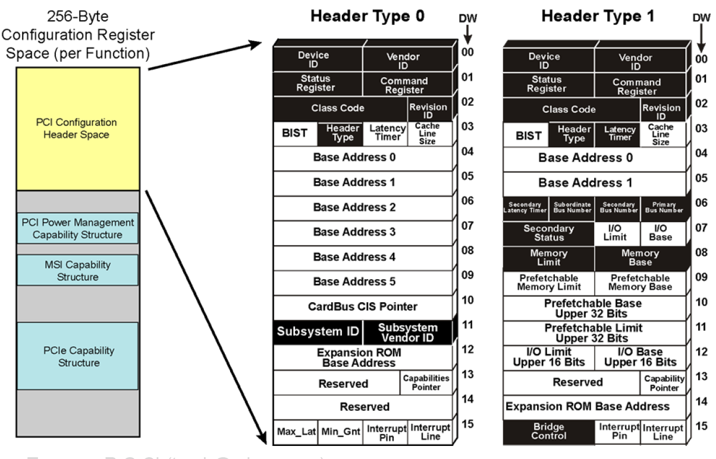
Configuration Registers and Initialization:
All PCI devices feature at least a 256-byte address space. The first 64 bytes are standardized, while the rest are device dependent.
PCI-e size is 4k

Slide 15
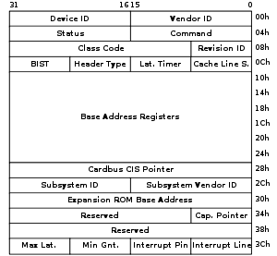
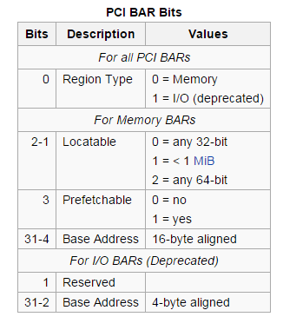
The Vendor ID (VID) and Device ID (DID) registers identify
the device (such as an IC), and are commonly called the
PCI ID.
The 16-bit vendor ID is allocated by the PCI-SIG.
The 16-bit device ID is then assigned by the vendor.
The Subsystem Vendor ID (SVID) and the Subsystem ID (SSID)
differentiate specific model (such as an add-in card). While
the Vendor ID is that of the chip manufacturer, the
Subsystem Vendor ID is that of the card manufacturer.
The Status register is used to report which features are
supported and whether certain kinds of errors have occurred.
The Command register contains a bitmask of features that can be
individually enabled and disabled.
The Header Type register values determine the different layouts of remaining 48 bytes (64-16) of the header, depending on the function of the device. That is, Type 1 headers for Root Complex, switches, and bridges. Then Type 0 for endpoints.
The Cache Line Size register must be programmed before the device is told it can use the memory-write-and-invalidate transaction. This should normally match the CPU's cache line size.

Slide 16
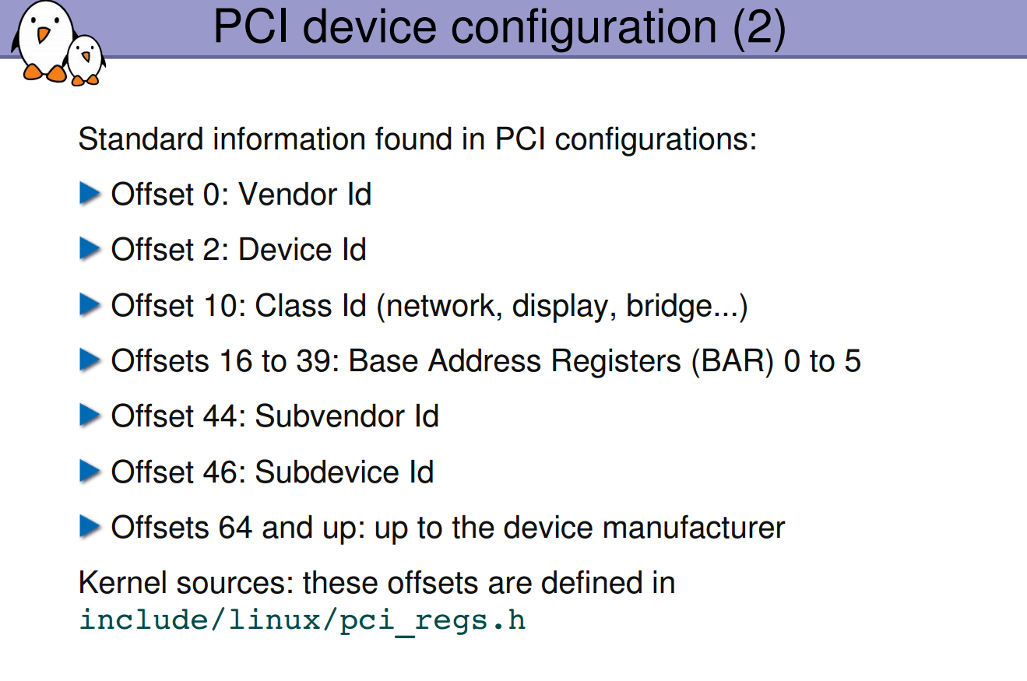

Slide 17
MODULE_DEVICE_TABLE:
This pci_device_id structure needs to be exported to user space to allow the hotplug and module loading systems know what module works with what hardware devices.
The macro MODULE_DEVICE_TABLE accomplishes this. An example is:
MODULE_DEVICE_TABLE(pci, i810_ids);
This statement creates a local variable called __mod_pci_device_table that points to the list of struct pci_device_id. Later in the kernel build process, the depmod program searches all modules for the symbol __mod_pci_device_table. If that symbol is found, it pulls the data out of the module and adds it to the file /lib/modules/
KERNEL_VERSION/modules.pcimap. After depmod completes, all PCI devices that are supported by modules in the kernel are listed, along with their module names, in that file. When the kernel tells the hotplug system that a new PCI device has been found, the hotplug system uses the modules.pcimap file to find the proper driver to Load
PCI devices contain three addressable regions: configuration space, I/O ports, and device memory. Let's learn how to access these memory regions from a device driver.
unsigned char irq;
pci_read_config_byte(pdev, PCI_INTERRUPT_LINE, &irq); pci_reg.h
PCI has up to six I/O or memory regions. I/O regions contain registers, and memory regions hold data.
Get the I/O base address from the appropriate base address register (bar) in the configuration space:
unsigned long io_base = pci_resource_start(pdev, bar);
request_region(io_base, length, "my_driver"); Here, length is the size of the control register space
unsigned long mmio_base = pci_resource_start(pdev, bar);
unsigned long mmio_length = pci_resource_length(pdev, bar);
unsigned long mmio_flags = pci_resource_flags(pdev, bar);
request_mem_region(mmio_base, mmio_length, "my_driver");

Slide 18
Implementing Linux Drivers

Slide 19
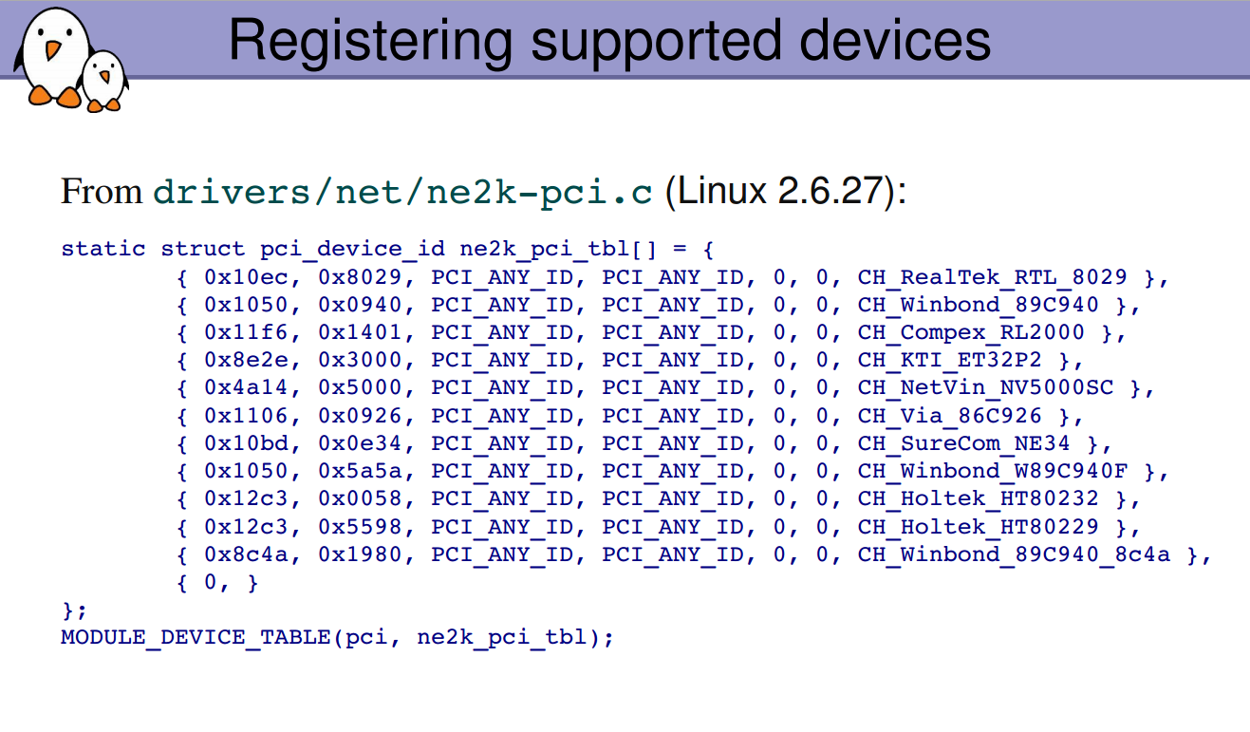

Slide 20
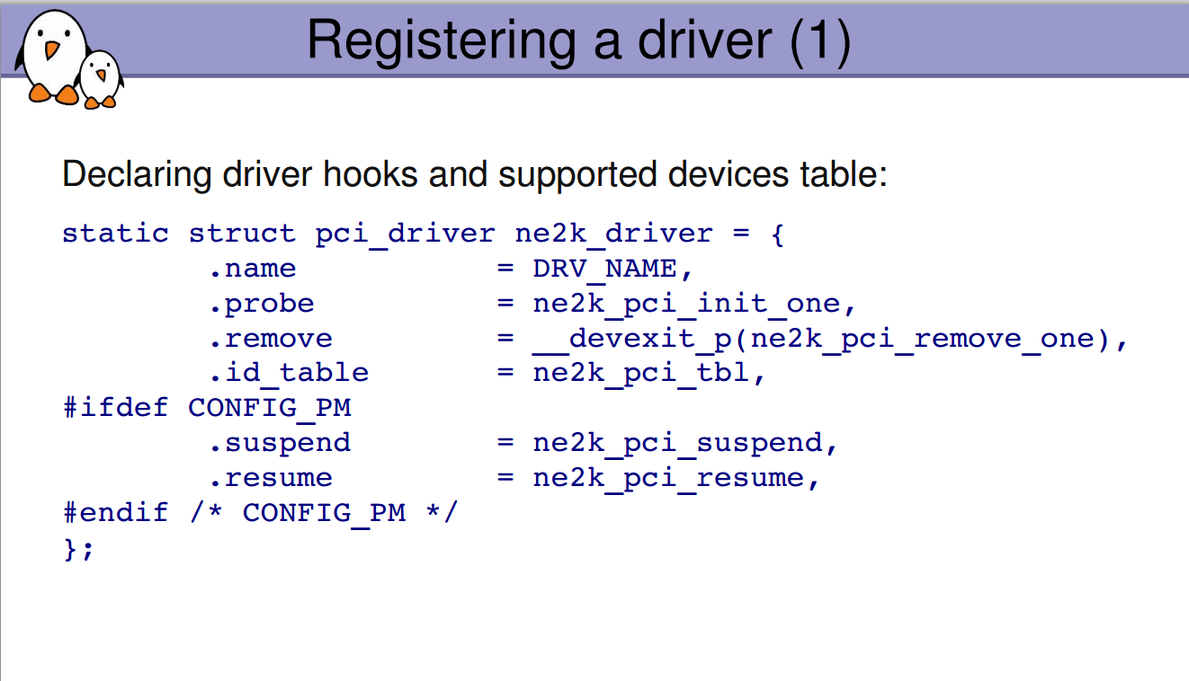

Slide 21
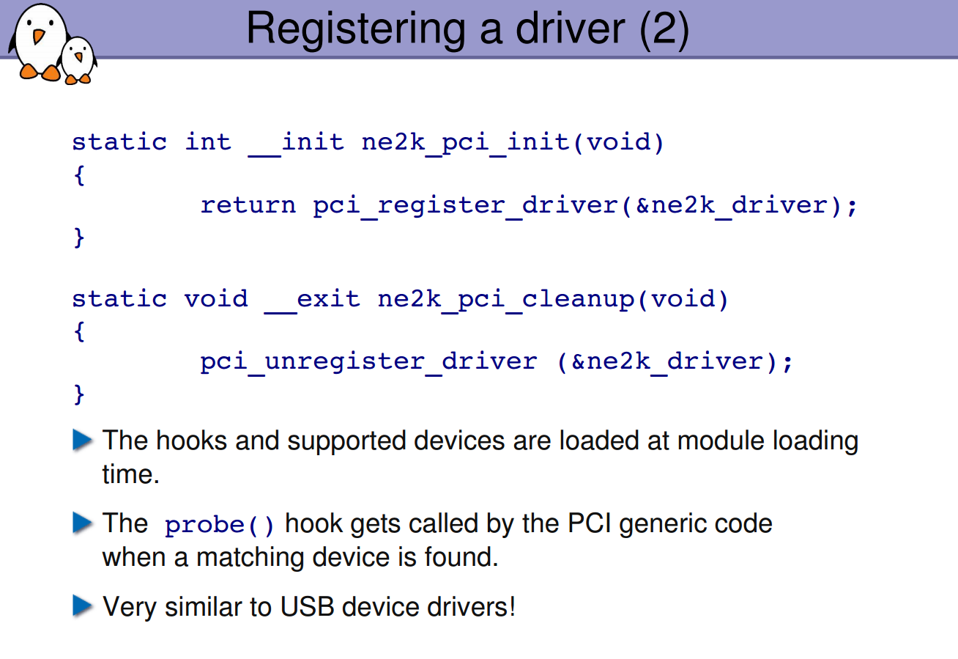

Slide 22
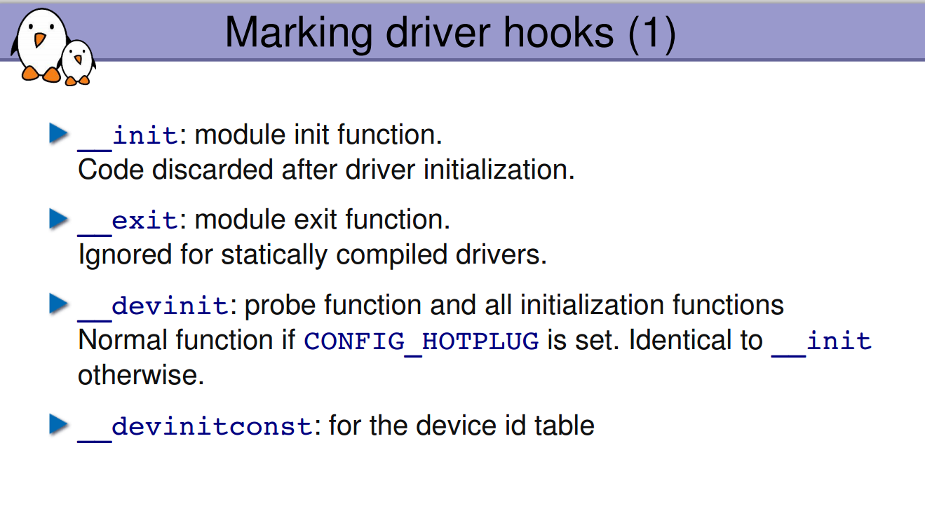

Slide 23


Slide 24
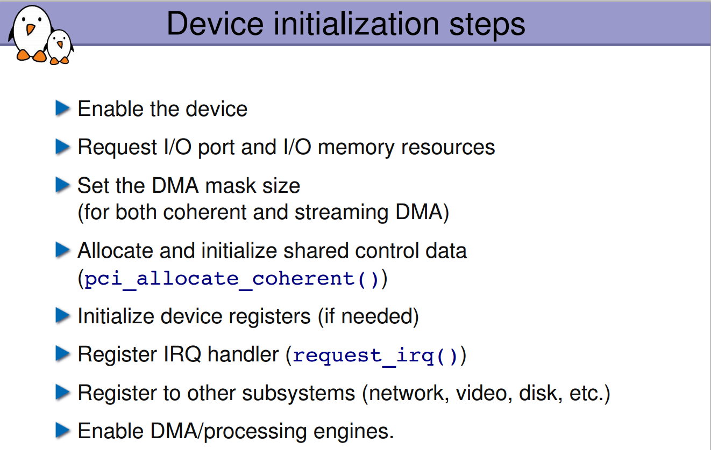

Slide 25
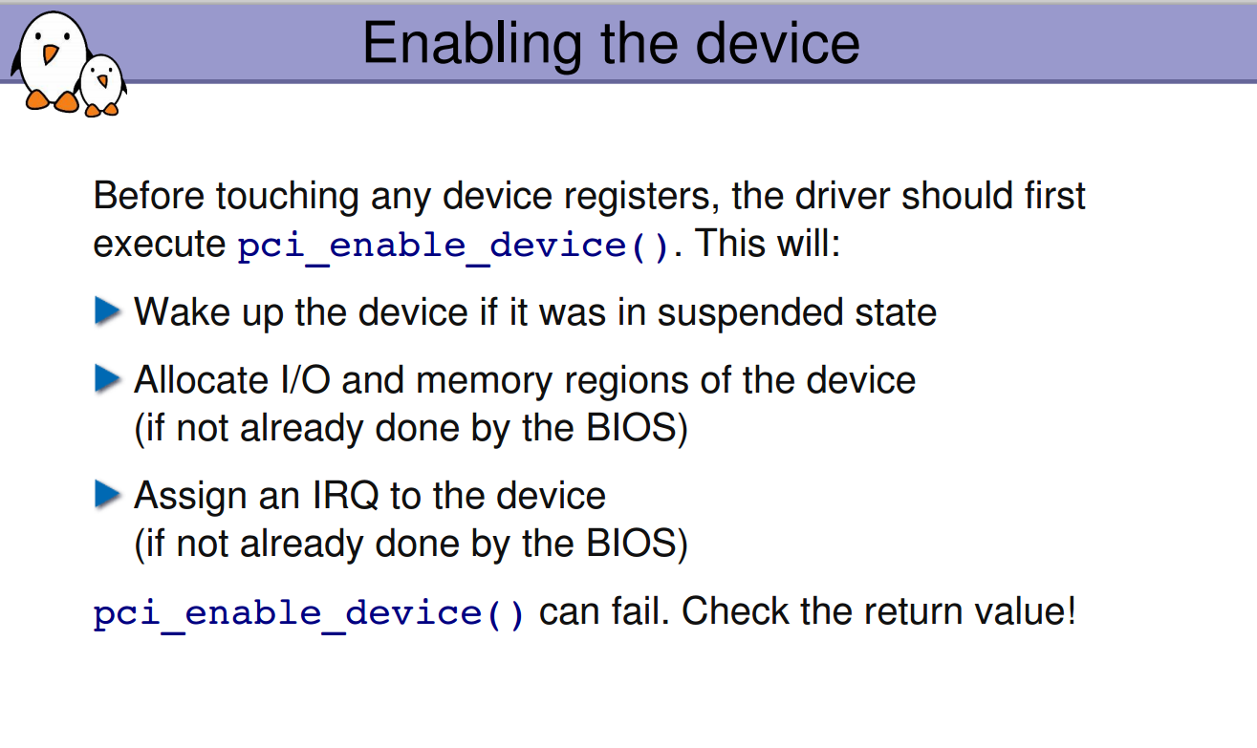

Slide 26
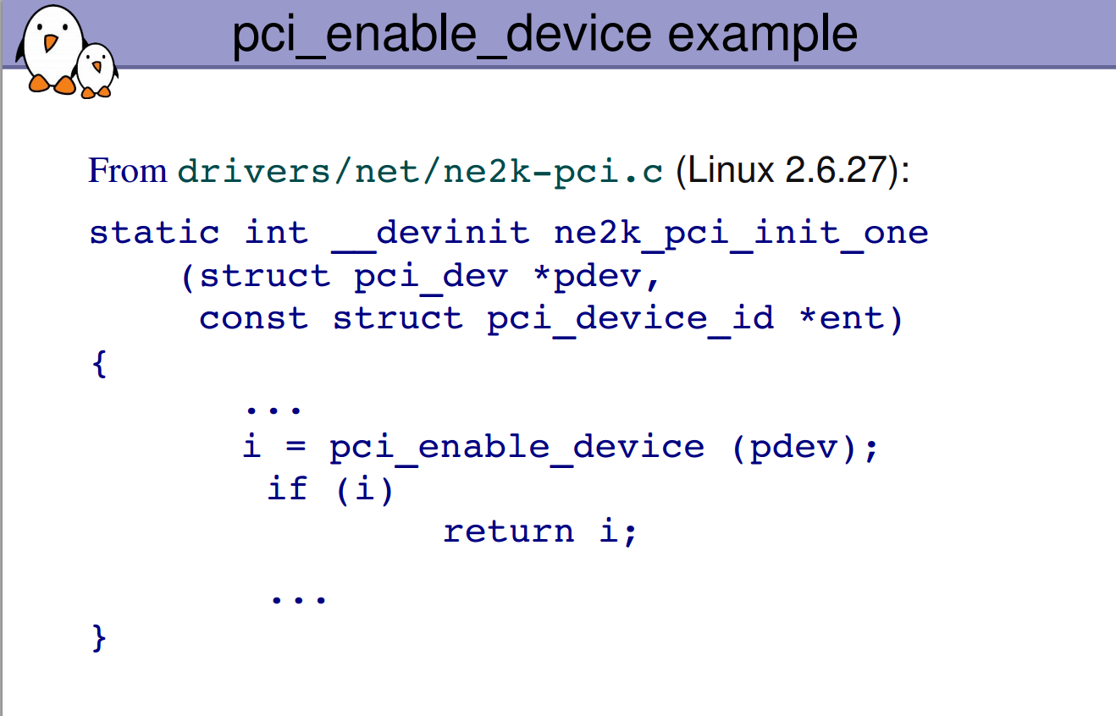

Slide 27
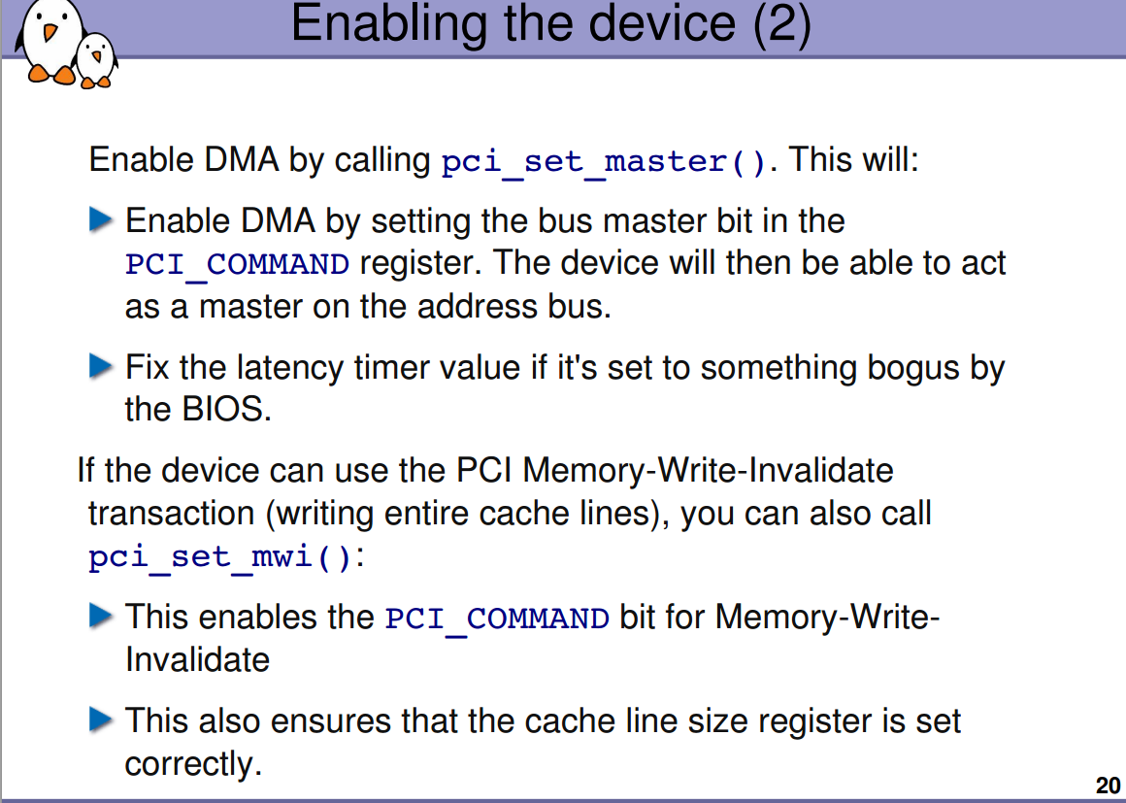

Slide 28
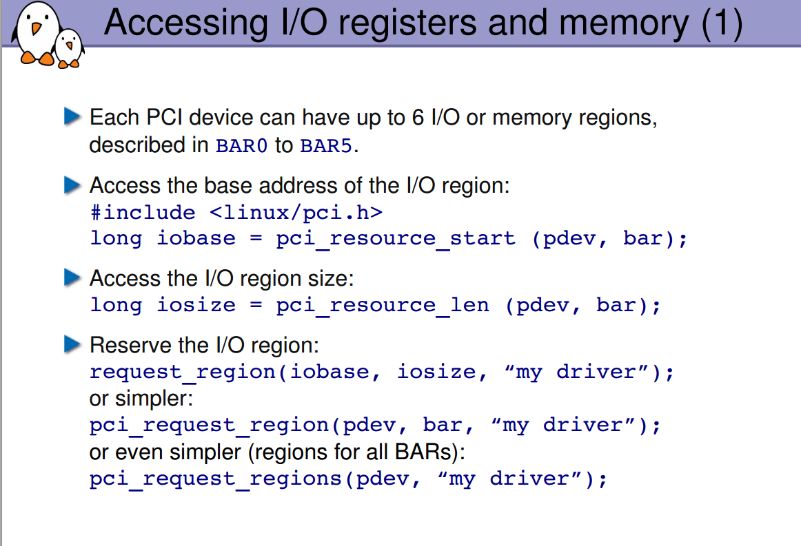

Slide 29
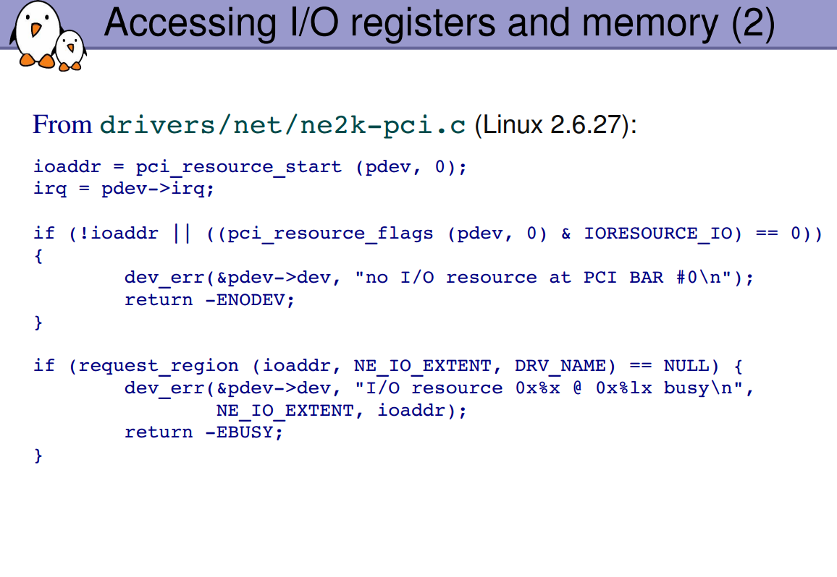

Slide 30
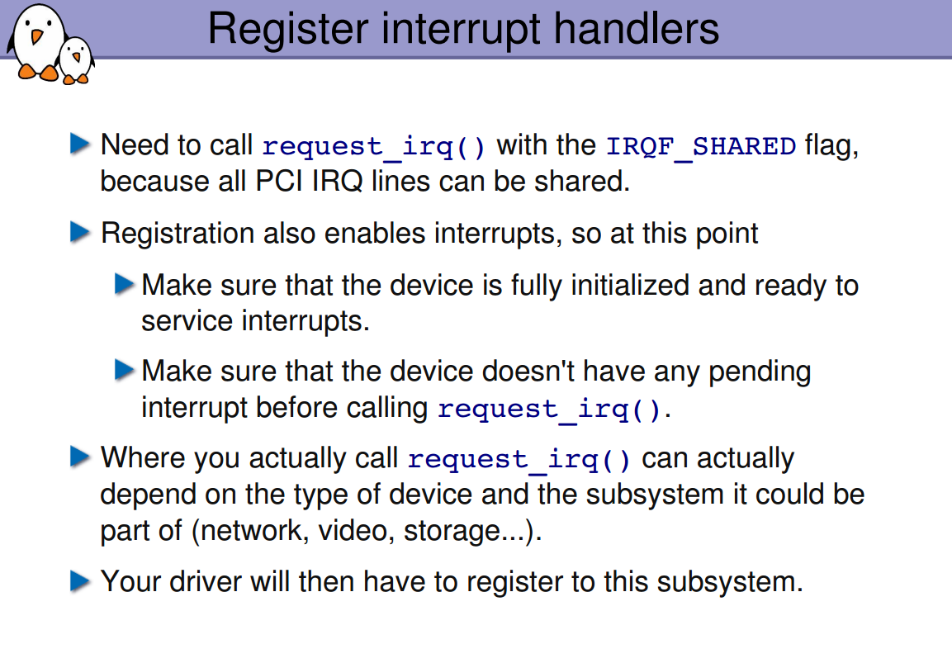
Explain Program On PCI Ethernet

Slide 31
pcim_iomap_regions Equal to
pci_request_region(), pci_iomap(), pci_iounmap(), pci_release_region()
No leak risk, No error-path spaghetti, Correct for hotplug & probe failures
void __iomem *bar0 = pcim_iomap_table(pdev)[0]; Index = BAR number.
pcim_enable_device
What it actually does Internally, it: Enables the PCI device Enables MMIO / I/O decoding Sets up power state (D0) Registers automatic cleanup with the PCI core.
Equal to
pci_enable_device();
pci_set_power_state(PCI_D0);
pci_set_master(pdev); - enables a PCI device to act as a bus master, meaning it can initiate DMA transactions on the PCI bus.
pci_alloc_irq_vectors() is the current, recommended PCI API for enabling interrupts. It replaces pci_enable_msi(), pci_enable_msix(), and most legacy IRQ handling. Minimum number of IRQ vectors. Maximum number of IRQ vectors.
int pci_alloc_irq_vectors(struct pci_dev *pdev, unsigned int min_vecs, unsigned int max_vecs, unsigned int flags);
PCI_IRQ_MSIX, Allow MSI-X
PCI_IRQ_MSI, Allow MSI
PCI_IRQ_LEGACY, Allow INTx
PCI_IRQ_ALL_TYPES, All of the above
ret = pci_alloc_irq_vectors(pdev, 4, 4, PCI_IRQ_MSIX);
for (i = 0; i < 4; i++) {
irq = pci_irq_vector(pdev, i);
request_irq(irq, handler[i], 0, "dev", data); }
free_irq(irq) … if (pci_dev_msi_enabled(pdev)) { pci_free_irq_vectors(pdev); }

Slide 32
A PCI Memory-Mapped I/O (MMIO) window is a specific range of system physical address space allocated to a PCIe device, allowing the CPU to interact with the device's internal registers and memory as if it were regular RAM. These windows are defined by Base Address Registers (BARs) during enumeration.
Key Aspects of PCI MMIO Windows:
Purpose: Enables high-speed communication by mapping device registers directly into the system's memory map.
Configuration: During BIOS/OS boot, the device requests a size, and the OS assigns a specific address range (a "window").
Addressing: Can be 32-bit (below 4GB) or 64-bit (above 4GB).
Mechanism: Reading/writing to these memory addresses causes the transaction to be routed over the PCIe bus to the device.
cat /proc/iomem
6000000000-601bffffff : PCI Bus 0000:01

Slide 33
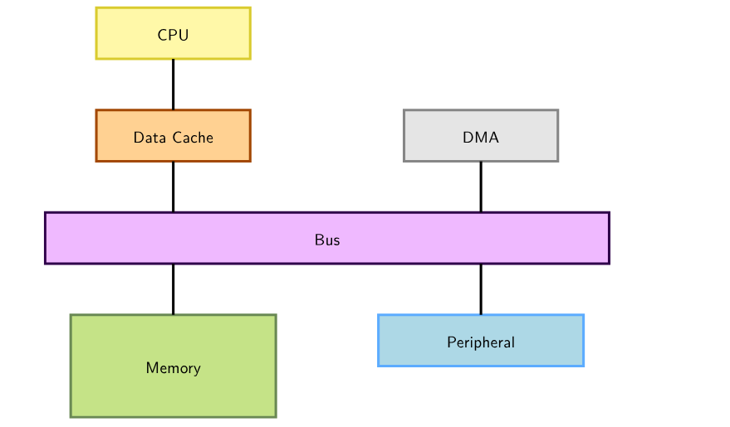
DMA (Direct Memory Access) is used to copy data directly between devices and RAM, without going through the CPU

Slide 34
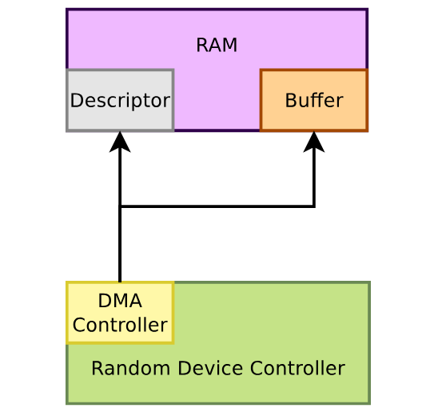
Peripheral DMA
Some device controllers embedded their own DMA controller and therefore can do DMA on their own.

Slide 35
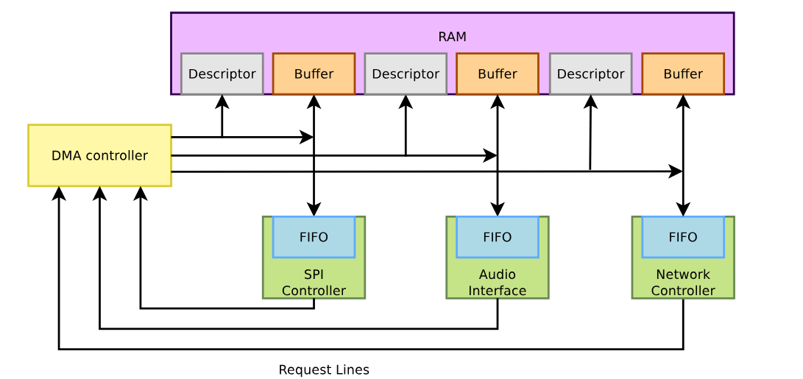
Other device controllers rely on an external DMA controller (on the SoC). Their drivers need to submit DMA descriptors to this controller

Slide 36
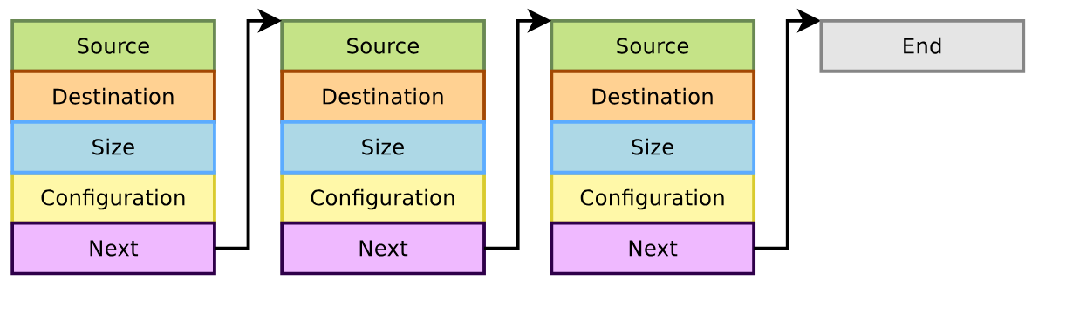
DMA descriptors describe the various attributes of a DMA transfer, and are chained.

Slide 37
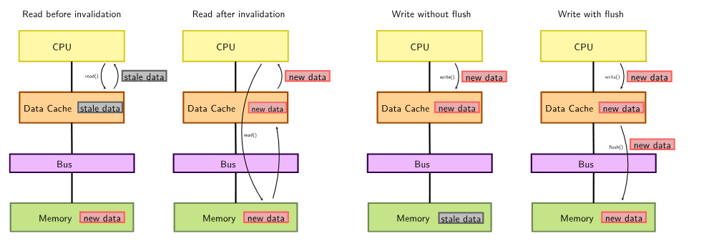
Cache constraints
The CPU can access memory through a data cache
• Using the cache can be more efficient (faster accesses to the cache than the bus)
▶ But the DMA does not access the CPU cache, so one needs to take care of cache
coherency (cache content vs. memory content):
• When the CPU reads from memory accessed by DMA, the relevant cache lines must
be invalidated to force reading from memory again
• When the CPU writes to memory before starting DMA transfers, the cache lines
must be flushed/cleaned in order to force the data to reach the memory

Slide 38
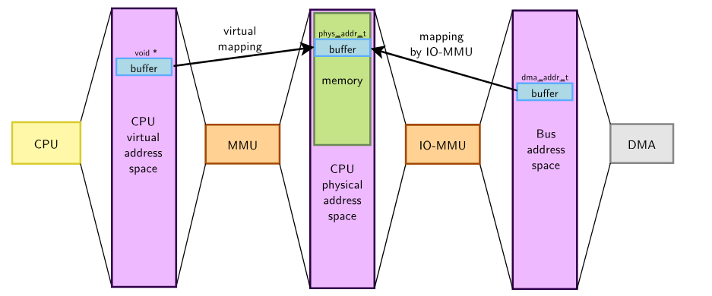
DMA addressing constraints
Memory and devices have physical addresses: phys_addr_t
▶ CPUs usually access memory through an MMU, using virtual pointers: void *
▶ DMA controllers do not access memory through the MMU and thus cannot
manipulate virtual addresses, instead they access a dma_addr_t through either:
• physical addresses directly
• an IOMMU, in which case a specific mapping must be created

Slide 39
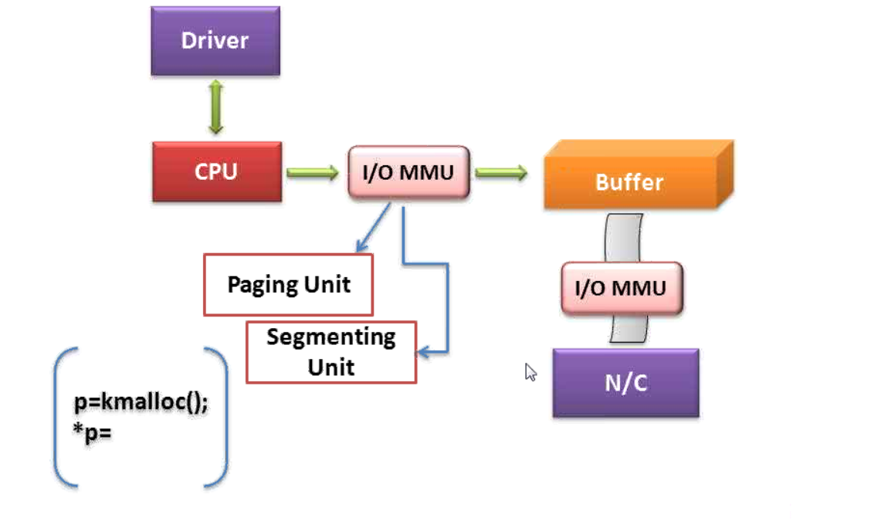
I/O devices view DMA buffers through the lens of the bus controller and any intervening I/O memory management unit (IOMMU). Because of this, I/O devices work with bus addresses, rather than physical or kernel virtual addresses. So, when you inform a PCI card about the location of a DMA buffer, you have to let it know the buffer's bus address. DMA service routines map the kernel virtual address of DMA buffers to bus addresses so that both the device and the CPU can access the buffers.

Slide 40
The dma-coherent property in a device tree indicates that a device is capable of coherent DMA operations, ensuring hardware-managed cache consistency between the device and CPU without explicit software flushing. It is primarily used on architectures that are non-coherent by default for I/O to enable cached memory usage for better performance.
Key Details Regarding dma-coherent in Device Tree:
Purpose: It allows the operating system to avoid unnecessary cache flushing and invalidation operations, which can significantly improve performance.
Usage: It is often added to DMA-capable peripherals (e.g., Ethernet, PCIe, or custom FPGA IP) that are connected to a system bus with a coherency interconnect.
Location: The dma-coherent property can be added to specific device nodes or to a bus node to indicate that all devices under that bus are coherent.
Alternatives: If the hardware does not support coherency, the dma-noncoherent property can be used to explicitly define that.
System Coherency: For devices needing a dedicated coherent memory region, a shared-dma-pool with the linux,dma-default property can be defined within the reserved-memory node
DMA on x86 architectures is generally cache-coherent, meaning CPU caches are automatically synchronized with device DMA transfers via bus-snooping, eliminating the need for manual cache flushing or invalidation in most drivers. The system agent or memory controller manages this, providing consistent, synchronous memory access.
Key Aspects of DMA Coherence on x86:
Automatic Snooping: Modern Intel/AMD CPUs use cache snooping, where the CPU's L3 cache tags are checked during DMA transfers to prevent stale data.
dma-coherent vs. Streaming: While x86 handles coherency automatically, developers should still use dma_alloc_coherent() for consistent memory (e.g., ring descriptors) and dma_map_single() for streaming, to ensure future compatibility and handle potential memory alignment issues.

Slide 41
DMA memory allocation constraints
The APIs must remain generic and handle all cases transparently, hence:
▶ Each memory chunk accessed by the DMA shall be physically contiguous, which
means one can use:
• any memory allocated by kmalloc() (up to 128 KB)
• any memory allocated by __get_free_pages() (up to 8MB) [old method]
struct page *page = alloc_page(GFP_KERNEL);
void *addr = page_address(page); // if lowmem
• block I/O and networking buffers, designed to support DMA
▶ Unless the buffer is smaller than one page, one cannot use:
• kernel memory allocated with vmalloc()
• user memory allocated with malloc()
Almost all the time userspace relies on the kernel to allocate the buffers and mmap()
them to be usable from userspace (requires a dedicated user API)

Slide 42
dma-mapping: Coherent or streaming DMA mappings
Coherent mappings
• The kernel allocates a suitable buffer and sets the mapping for the driver
• Can simultaneously be accessed by the CPU and device
• So, has to be in a cache coherent memory area
• Usually allocated for the whole time the module is loaded
Can be expensive to setup and use on some platforms
Typically implemented by disabling cache on ARM
▶ Streaming mappings
• Use an already allocated buffer
• The driver provides a buffer, the kernel just sets the mapping
• Mapping set up for each transfer (keeps DMA registers free on the hardware)
▶ The default addressing capability of the DMA controllers is assumed to be 32-bit.
▶ If the platform supports it, the DMA addressing capability can be:
• increased (eg. need to access highmem)
• decreased (eg. ISA devices, where kmalloc() buffers can also be allocated in the first part of the RAM with GFP_DMA)
Linux stores this capability in a per-device mask, DMA mappings can fail because a buffer is out of reach
▶ In all cases, the DMA mask shall be consistent before allocating buffers
int dma_set_mask_and_coherent(struct device *dev, u64 mask)

Slide 43
Maximum and optimal buffer sizes can also be retrieved to optimize
allocations/buffer handling
size_t dma_max_mapping_size(struct device *dev);
size_t dma_opt_mapping_size(struct device *dev);
Allocating coherent memory mappings. The kernel takes care of both buffer allocation and mapping
#include <linux/dma-mapping.h>
void * /* Output: buffer address */
dma_alloc_coherent(
struct device *dev, /* device structure */
size_t size, /* Needed buffer size in bytes */
dma_addr_t *handle, /* Output: DMA bus address */
gfp_t gfp /* Standard GFP flags */
);
void dma_free_coherent(struct device *dev, size_t size, void *cpu_addr, dma_addr_t handle);

Slide 44
Setting up streaming memory mappings (single)
Works on already allocated buffers:
#include <linux/dma-mapping.h>
dma_addr_t dma_map_single(
struct device *, /* device structure */
void *, /* input: buffer to use */
size_t, /* buffer size */
enum dma_data_direction /* Either DMA_BIDIRECTIONAL,
* DMA_TO_DEVICE or
* DMA_FROM_DEVICE */
);
void dma_unmap_single(struct device *dev, dma_addr_t handle,
size_t size, enum dma_data_direction dir);

Slide 45
Physical addresses with MMIO registers might need to be remapped in order to be accessed through an IO-MMU:
#include <linux/dma-mapping.h>
dma_addr_t dma_map_resource(
struct device *, /* device structure */
phys_addr_t, /* input: resource to use */
size_t, /* buffer size */
enum dma_data_direction, /* Either DMA_BIDIRECTIONAL,
* DMA_TO_DEVICE or
* DMA_FROM_DEVICE */
unsigned long attrs, /* optional attributes */
);
void dma_unmap_resource(struct device *dev, dma_addr_t handle,
size_t size, enum dma_data_direction dir, unsigned long attrs);
dma_map_resource() is the DMA API you reach for when the memory you want to DMA was not allocated by the CPU.
Typical cases: BAR memory on PCI devices, on-chip SRAM, carveouts / reserved memory, firmware-provided buffers, persistent memory (PMEM)

Slide 46
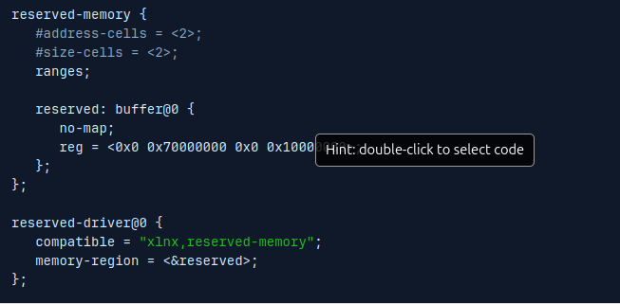
In Linux / Yocto (especially with Device Tree–based platforms), reserved-memory is used when you want to reserve a region of physical RAM that the kernel must not use as normal system memory.
reserved-memory is a Device Tree node used to:
1. Carve out memory at boot time
2. Prevent the Linux kernel from allocating it to general use
3. Make that memory available to specific hardware or software components
1️⃣ DMA buffers for devices
Devices that:
1. Cannot use IOMMU (lspci -v | grep -i iommu)
2. Require physically contiguous memory
3. Have addressing limitations
Examples:
Ethernet, Video/Camera, FPGA accelerator.
As the reserved memory region has been excluded for the common usage by the kernel and marked as no-map, the iomem information (/proc/iomem) shows that the System RAM is less than the amount of memory in the board.
root@plnx_aarch64:~# cat /proc/iomem
00000000-6fffffff : System RAM
00080000-00b37fff : Kernel code
011c9000-012b8fff : Kernel data

Slide 47
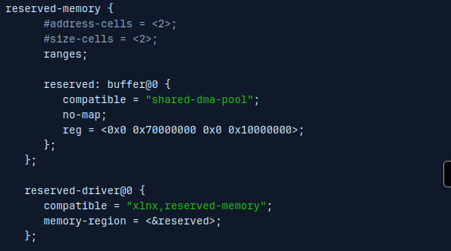
Reserved memory through DMA API
Commonly the reserved memory spaces are being used with DMA engines, so integrating both frameworks can be useful from the device driver point of view. For that particular purpose the compatible property can be set as shared-dma-pool, generating a DMA memory pool reserved for a particular device driver.
reserved-memory {
#address-cells = <2>;
#size-cells = <2>;
ranges;
dma_pool: dma_pool@70000000 {
compatible = "shared-dma-pool";
reg = <0x0 0x70000000 0x0 0x1000000>; // 16 MB
no-map;
};
};
ethernet@a0000000 {
compatible = "xlnx,axi-ethernet";
memory-region = <&dma_pool>;
};
This way the device driver only need to use the DMA API in the regular way.
[ 0.000000] Reserved memory: created DMA memory pool at 0x0000000070000000, size 256 MiB[ 0.000000] Reserved memory: initialized node buffer@0, compatible id shared-dma-pool

Slide 48
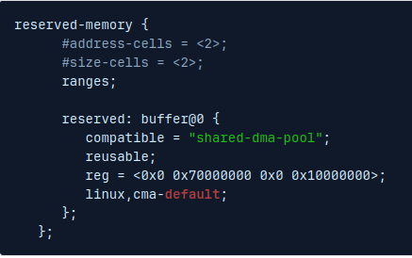
Reserved memory for CMA
CMA reserves a contiguous memory pool at boot, but:
1.Memory is temporarily usable by Linux
2.It is migrated away and reclaimed on demand
3.Allocations happen at runtime
4.CMA is implemented by the kernel’s Contiguous Memory Allocator.
When a device:
1. Needs physically contiguous buffers
2. Can work with dynamic addresses
3.Uses Linux DMA APIs
Sometimes the reserved memory region does not require to be assigned to an specific device driver and is only intended to have a bigger CMA memory pool than the default one. For that particular use case, an extra property can be used to point to the kernel to use the reserved memory region as the default CMA memory pool.
Kernel can reclaim memory when not used (makes it behave like CMA). //reusable
ethernet@a0000000 {
compatible = "xlnx,axi-ethernet";
reg = <0x0 0xa0000000 0x0 0x10000>;
memory-region = <&reserved>;
/* DMA buffer allocation from this reserved region */
dma-coherent;
};
This ties the Ethernet driver to your CMA-reserved memory. dma_alloc_coherent() will pick memory from this pool automatically.
The kernel bootlog confirms the custom CMA memory pool allocation:
[ 0.000000] Reserved memory: created CMA memory pool at 0x0000000070000000, size 256 MiB
[ 0.000000] Reserved memory: initialized node buffer@0, compatible id shared-dma-pool

Slide 49
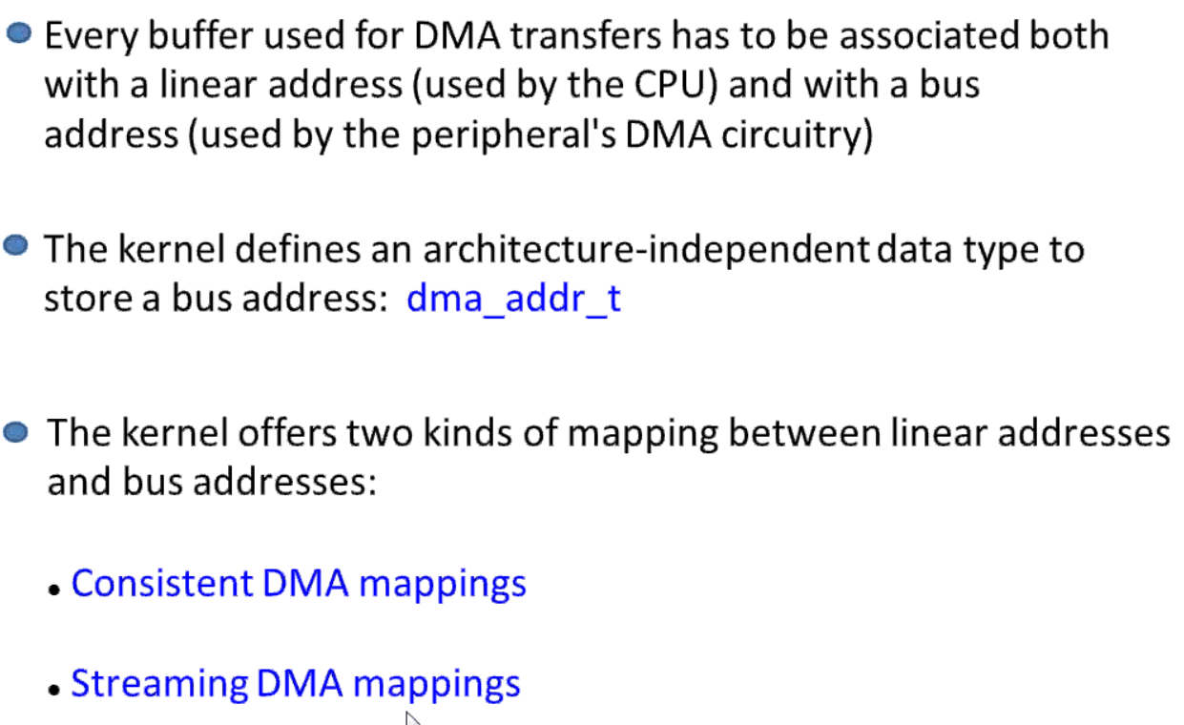

Slide 50

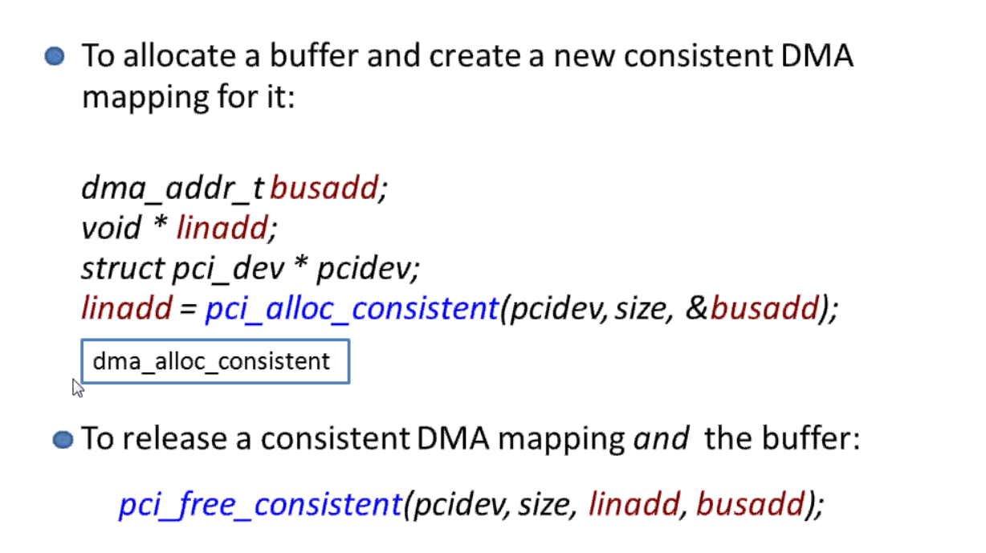

Slide 51
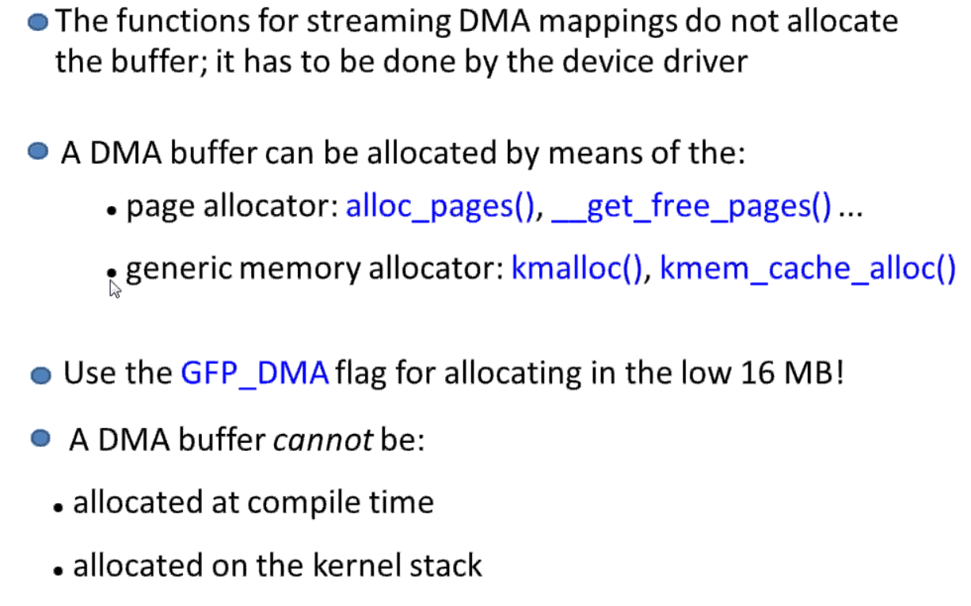
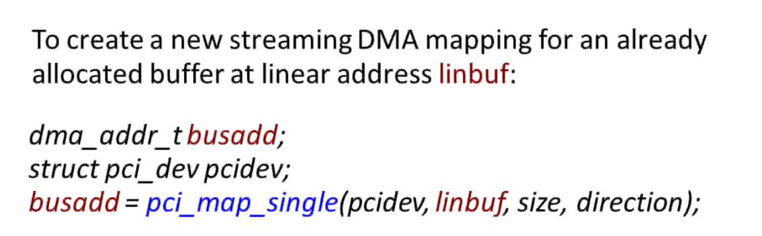
Stream DMA Mapping

